Slide 1
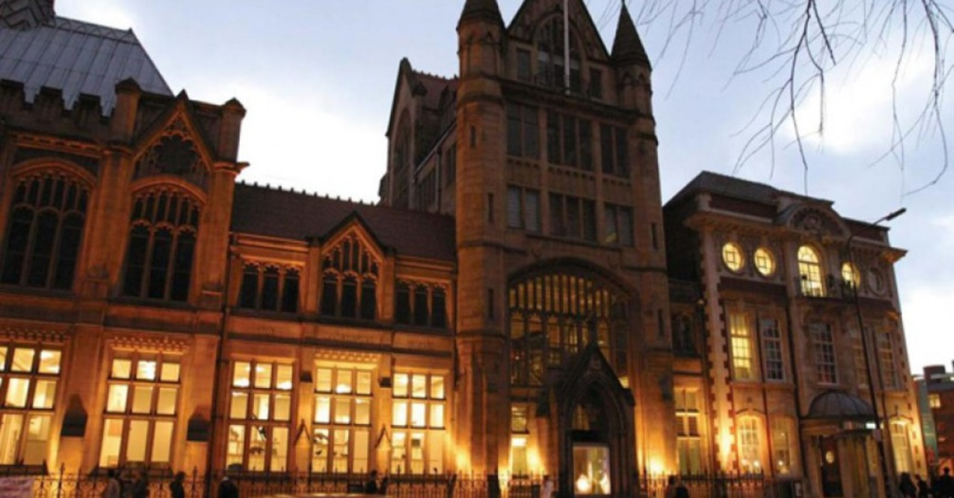
The University of Manchester
Kushpenova Dilyara

Slide 2
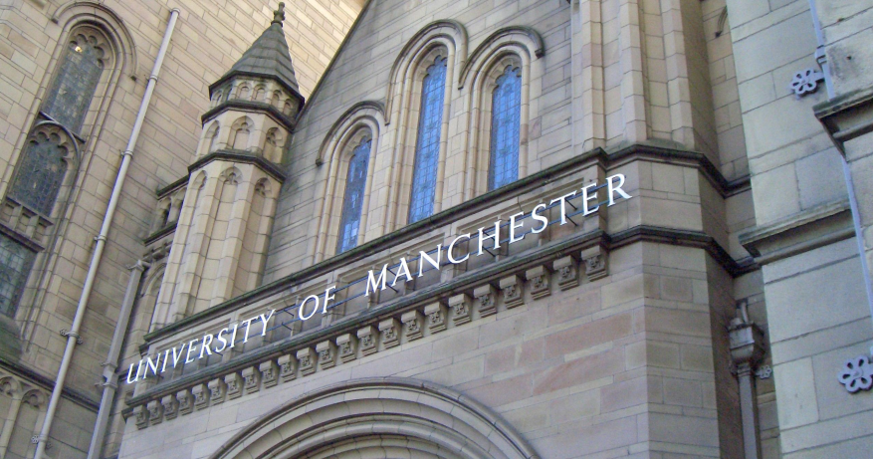
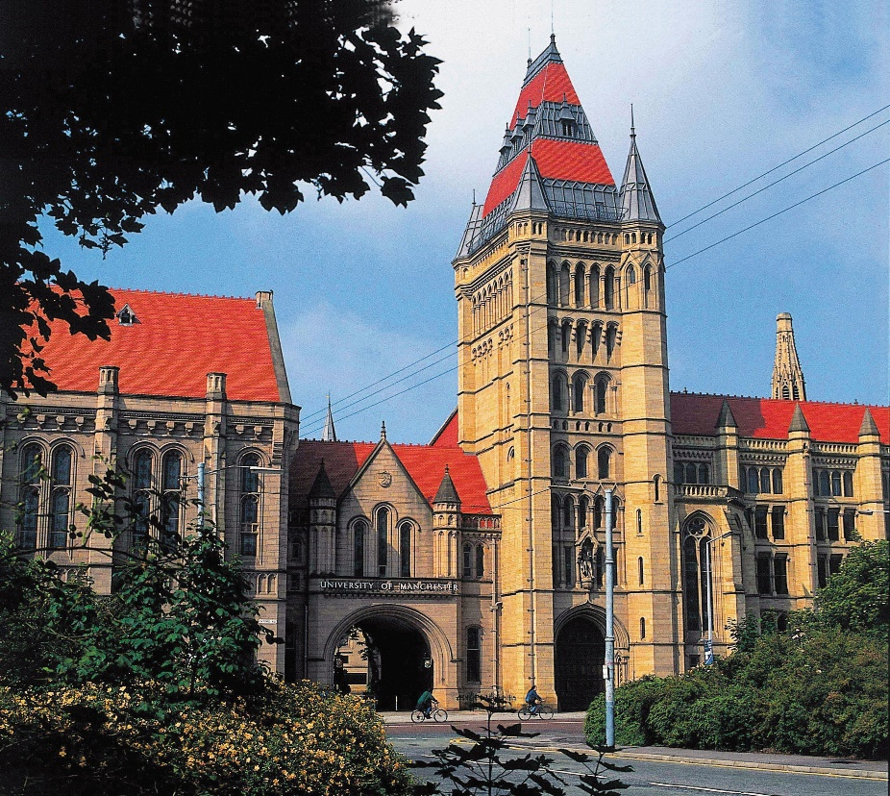
The University of Manchester is one of the most important higher education institutions in the UK. The date of Foundation of the University is considered to be 1824. Today, the University is in the third place among UK universities for the number of Nobel prizes received by employees or alumni of the University.

Slide 3
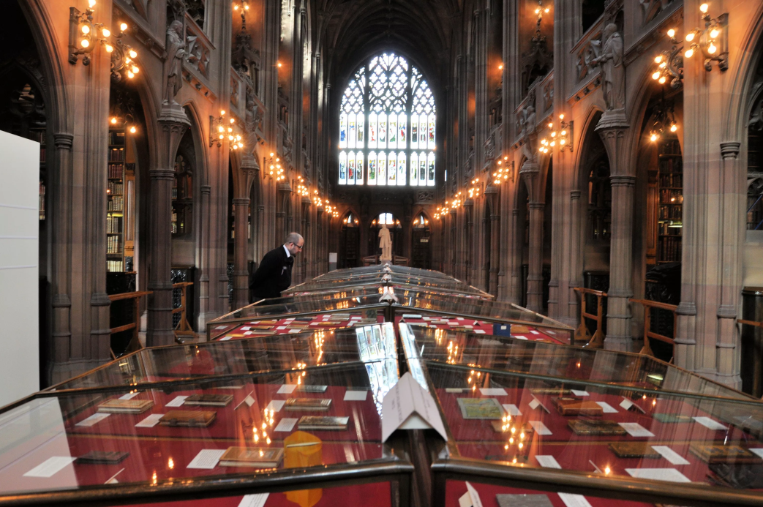
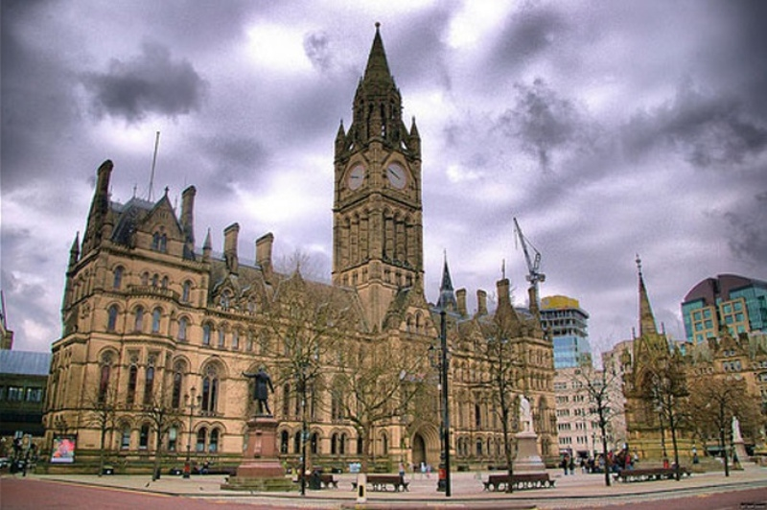
Today there are over 40 thousand students and staff of the University numbers about 10 thousand employees. Moreover, the competition in the University of Manchester is the highest in the country, and the University ranked fifth globally according to the level of demand for its graduates.

Slide 4
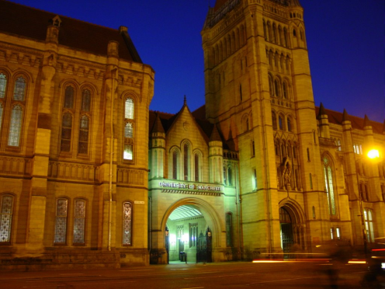
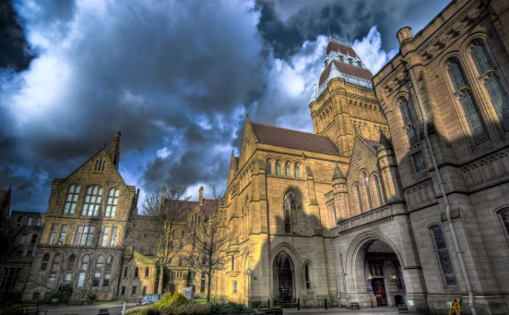
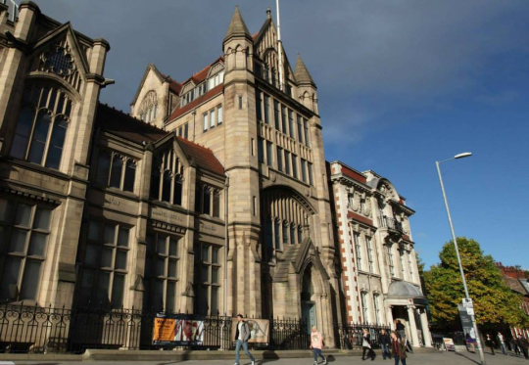
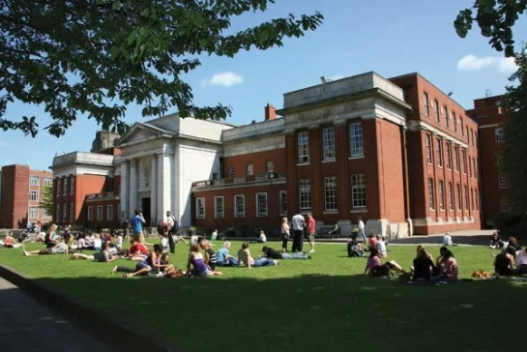
Today, the University of Manchester offers received training in four faculties: medical faculty, the faculty of Humanities, faculty of life Sciences (science) in the faculty of engineering and physical Sciences.

Slide 5
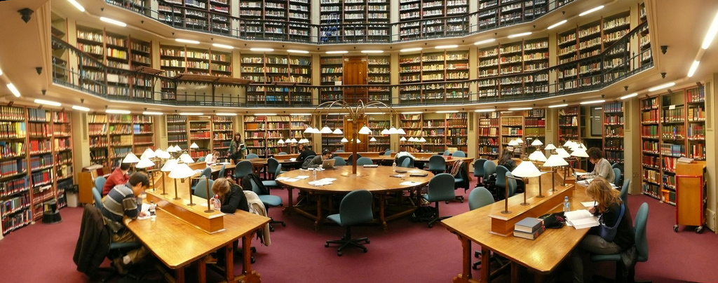
The structure of the University includes one of the largest libraries in Britain, which houses more than 4 million books and various publications. The number of computers for students in the University area is one of the biggest in Europe.

Slide 6
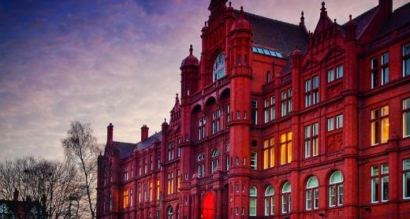
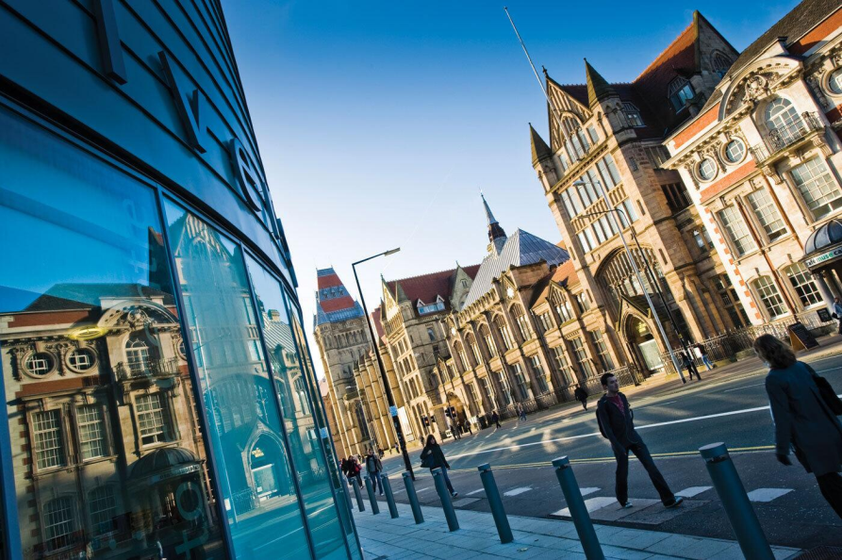
Almost all the students of the University of Manchester in the annual surveys indicate that they are satisfied with the quality of education. Foreigners account for almost half of all students here, which indicates the high popularity of Universities in the world.

