Slide 1
SPORTS
during
HOLIDAYS

Slide 2
Phonetic warm-up

Slide 4
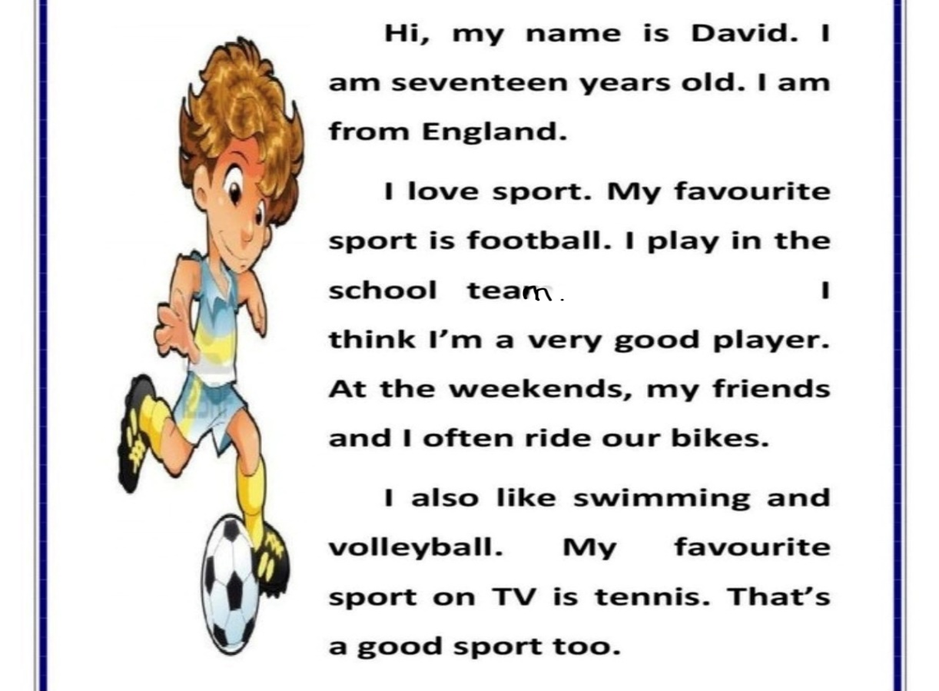
Reading

Slide 5
Physical Exercise

Slide 6
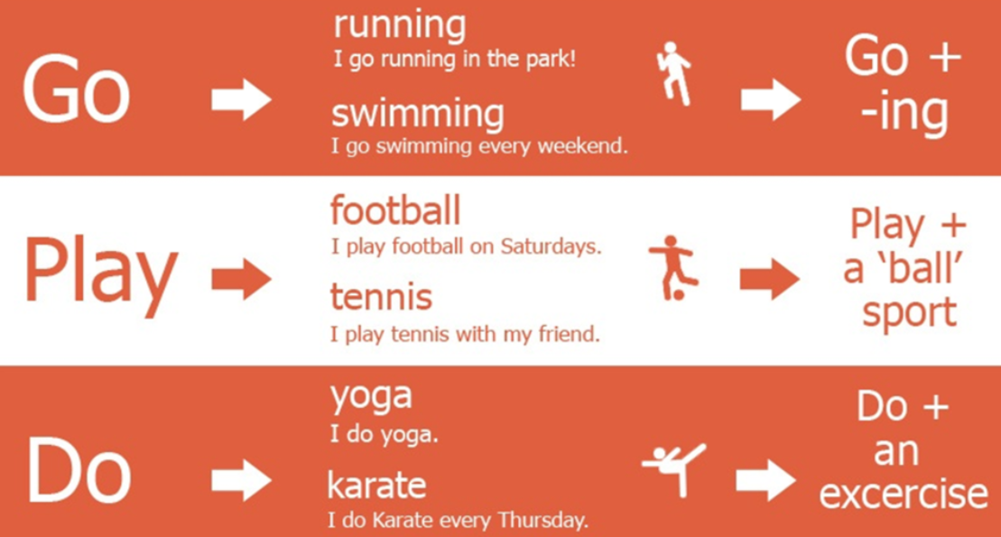
Rule

Slide 7
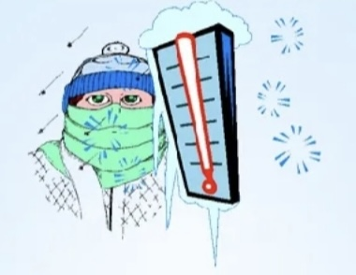
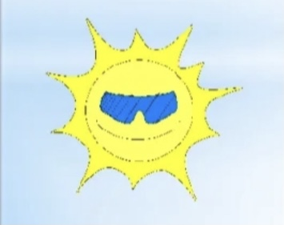
Will…
It will be cold. I will …
It will be warm. I will …

Slide 8
What do you think about the lesson?
I like it! I don’t know… I don’t like it.

Slide 9
GOODBYE!

