Slide 1
Metals

Slide 2
Guess what these words mean
aluminium
bronze
exporter
mineral resources
nickel
reserve
uranium
zinc

Slide 3
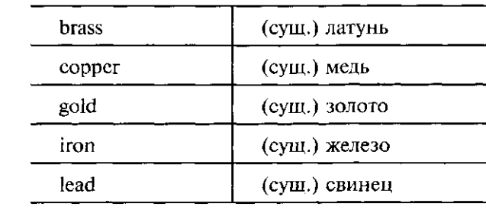
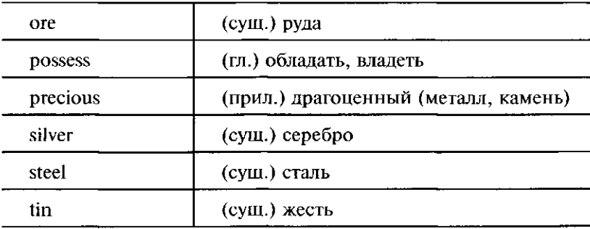
2.Study the vocabulary

Slide 4
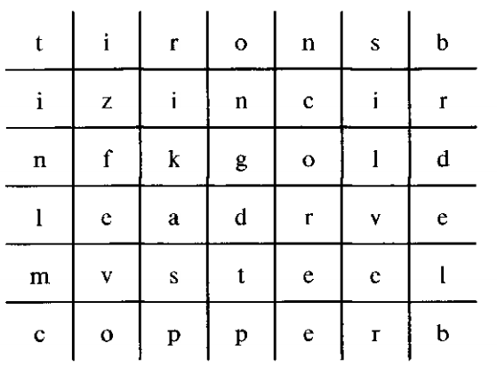
4. Find the 8 new words in the word puzzle

Slide 5
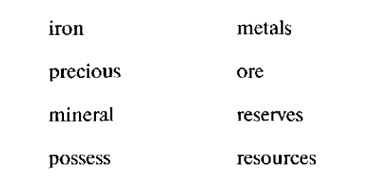
5. Match the words in the columns to make phrases

Slide 7
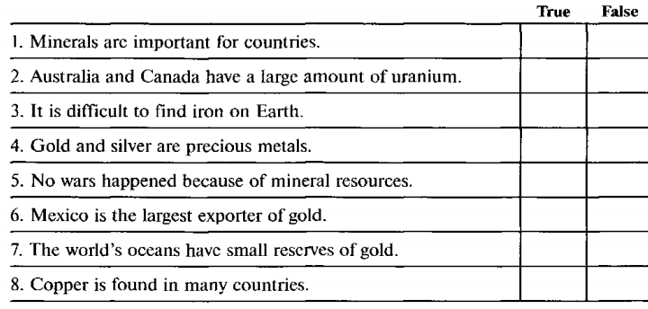
7. Choose True or False for each statement

Slide 8
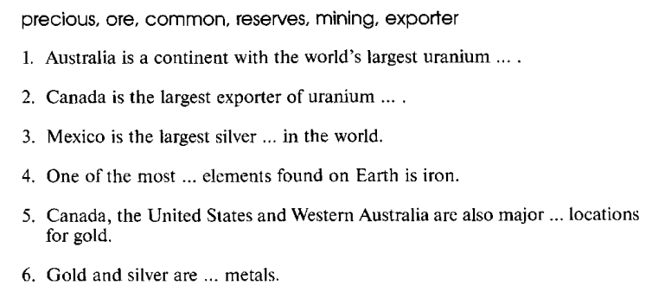
8. Complete the sentences using the given words

Slide 9
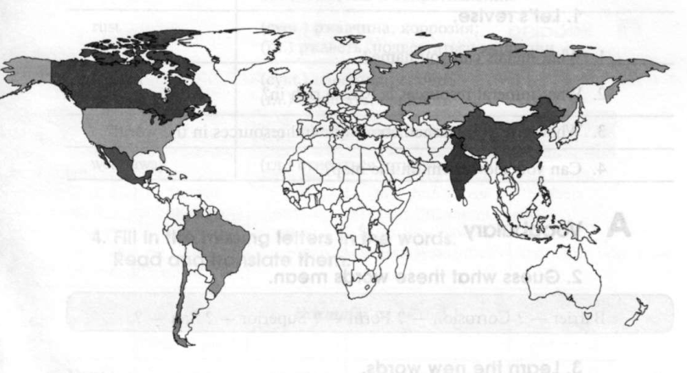
9. Look at the map and mark the countries and their natural resources using the information in the text

