Slide 1
GOOD MORNING, CHILDREN!

Slide 4
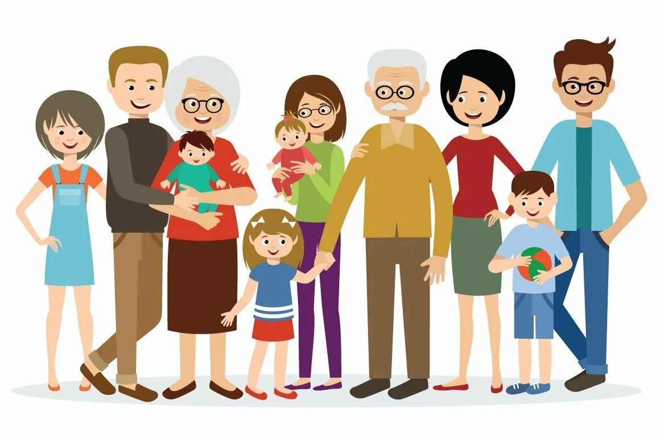

Slide 6
What’s the topic of our lesson?
Let’s suggest!

Slide 7
ME

Slide 8
ME
MUMMY
DADDY
GRANNY
GRANNY
GRANDPA

Slide 11
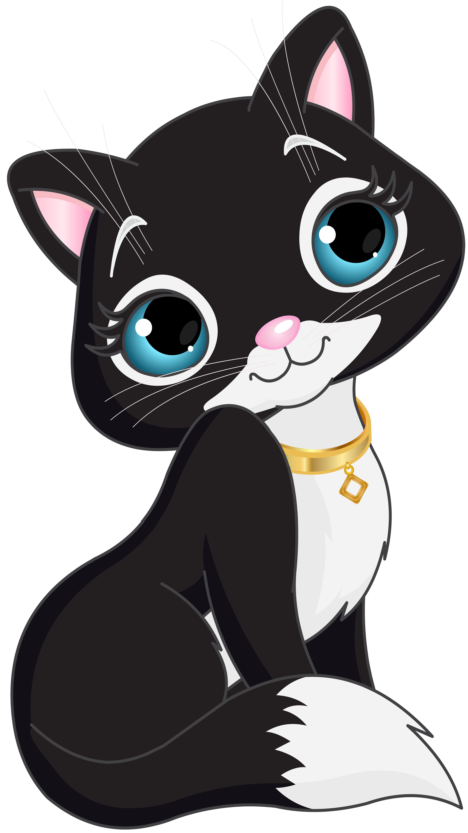
Притяжательный падеж
Чей? Чья? Чьи?
I
he
she
it
you
we
they
+сущ.
my cat
his
her
its
your
our
their
нет сущ.
mine
his
hers
its
yours
ours
theirs
!
!
+s
+s
!
+s
+s

Slide 13
Tell me more abut your family!
Work in the garden
Play the piano
Study at the university
Cook the dinner
Clean my room
Listen to music
Learn the poem by heart
Go shopping

Slide 14
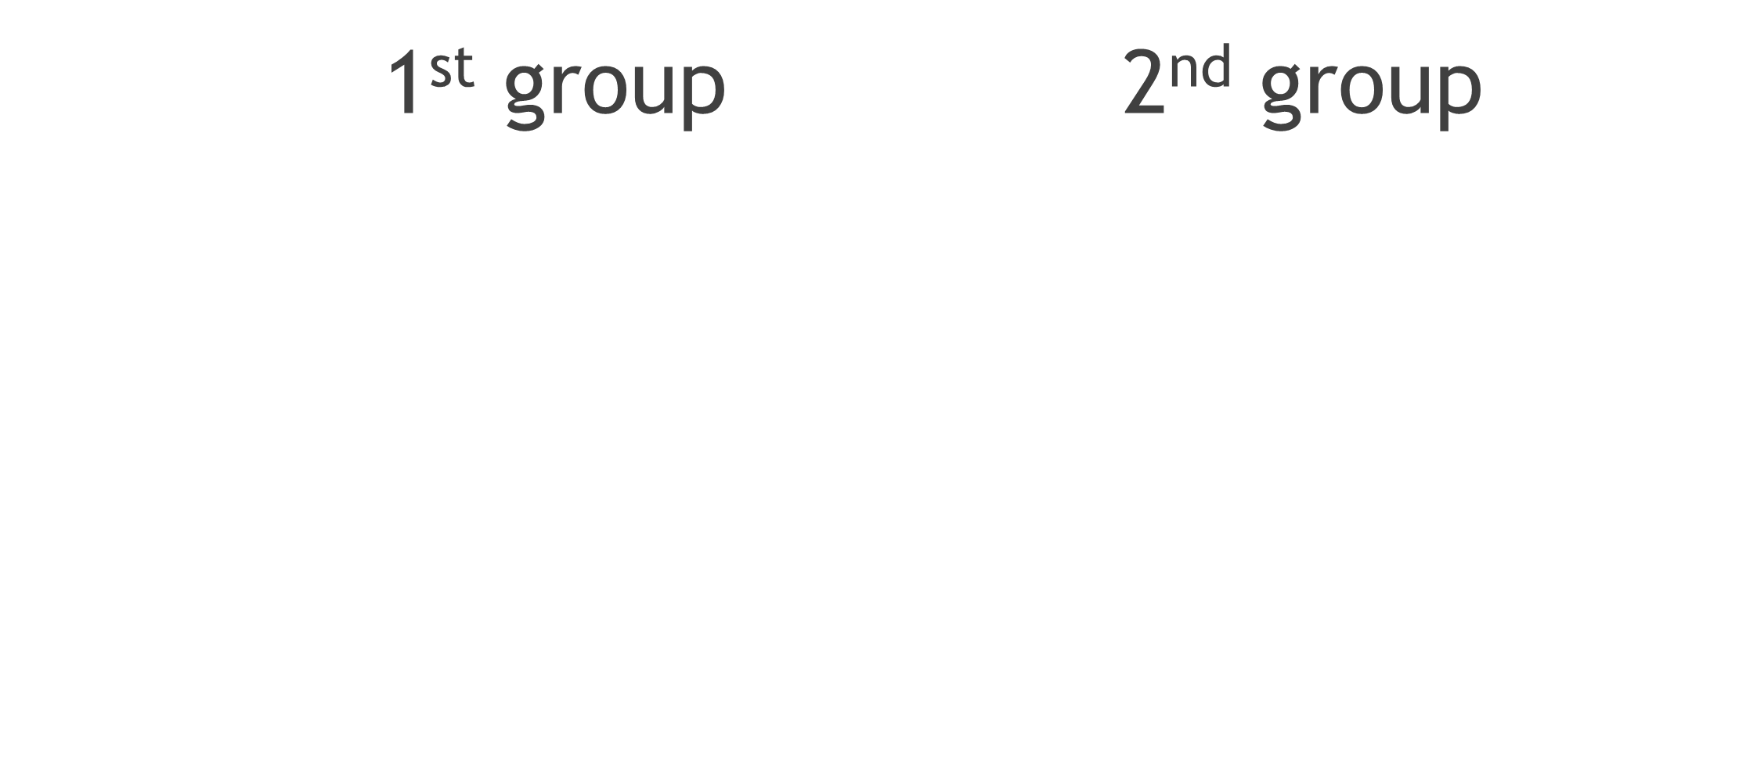

Slide 15
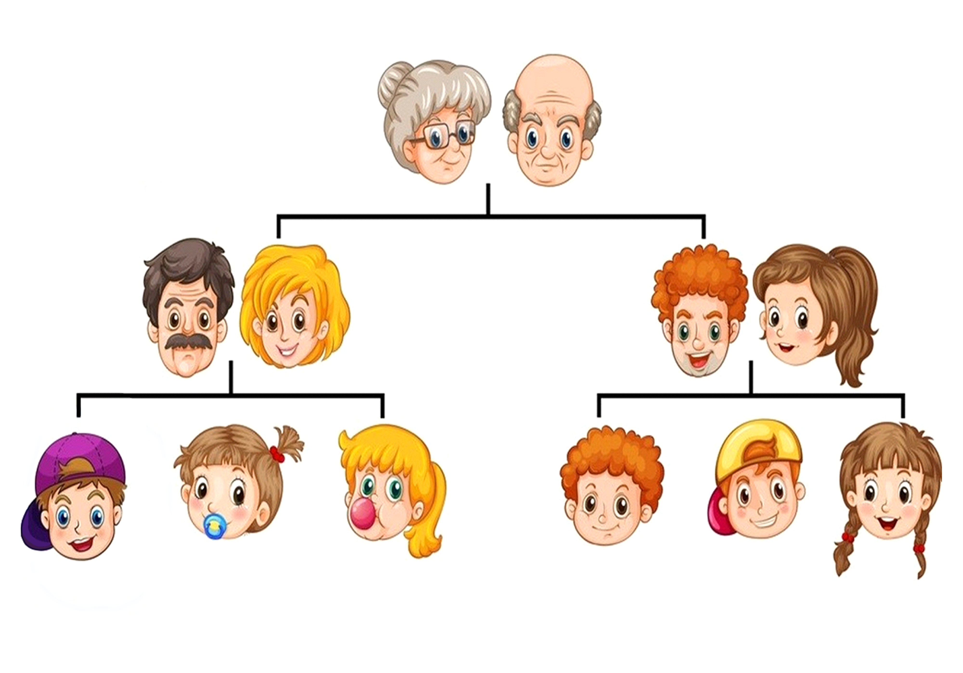
1st group 2nd group
MARY JOHN
TOM LINDA HARRY SANDY
TIM JANE EMMA PAUL PETER ANN

Slide 16
WELL DONE! THE LESSON IS OVER, YOU ARE FREE, GOOD BYE!

