Slide 1
Урок английского языка в 8 классе
по теме:
« Досуг. Спорт. Хобби »
автор:
Курбанова Наталья Геннадиевна,
Учитель ГБОУ РЦДО г.Уфа

Slide 2
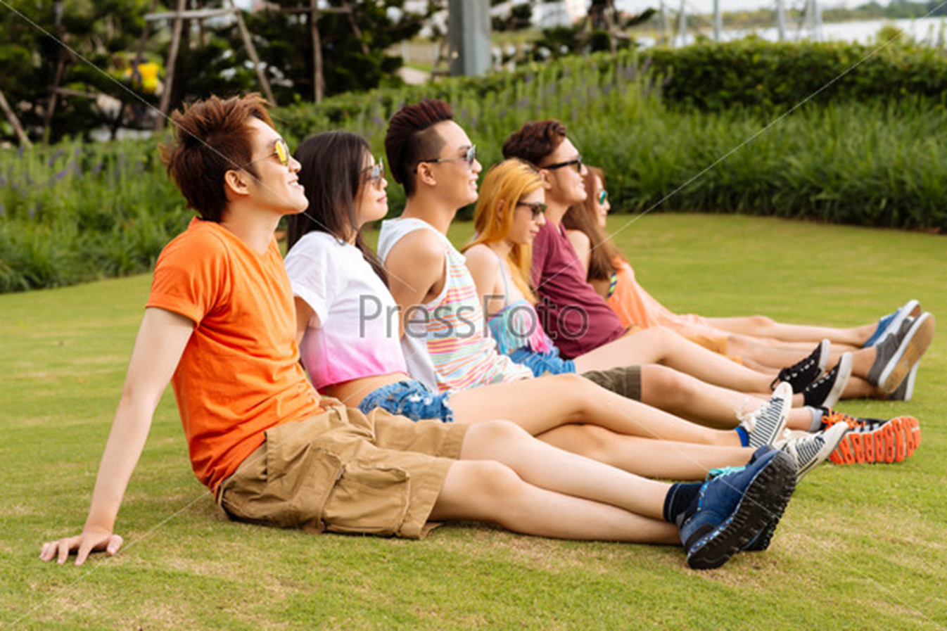
Notes:
<номер>

Slide 3
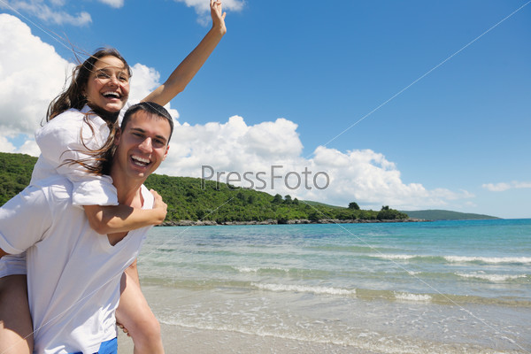

Slide 4
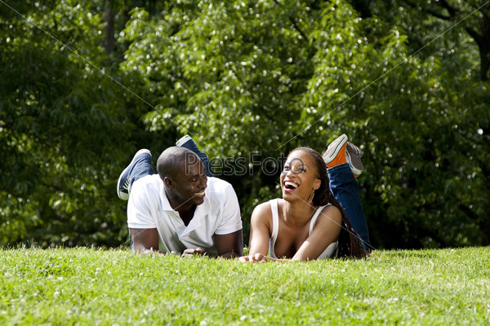

Slide 5
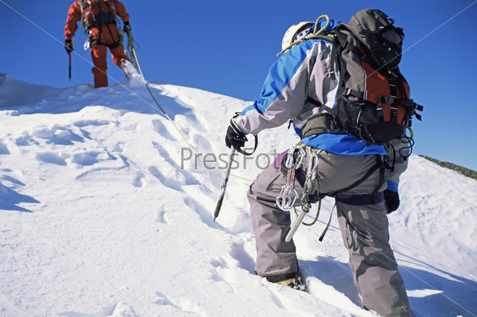

Slide 6
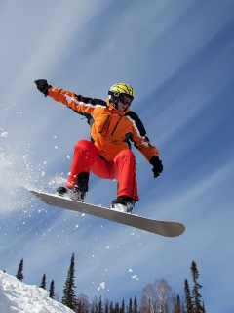

Slide 7
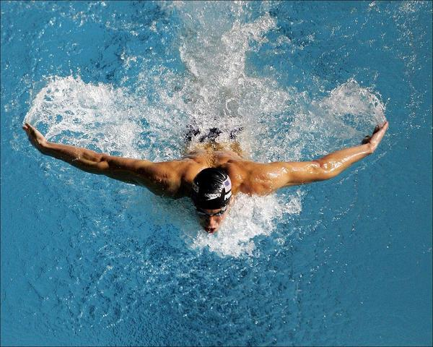

Slide 8
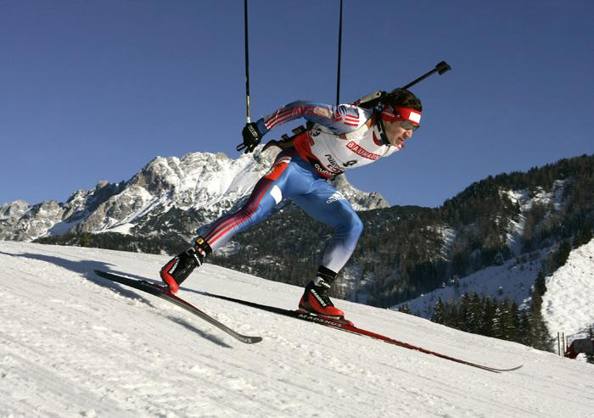
Pastimes. Sports

Slide 9
We must
Listen to and read the texts
Fill in
Listen to, read, act out
Write a few word about your favorite sports

Slide 10
Fill
sport | name | Country of origin | How long | General idea | equipment | + | -
sandboarding | Brian Potter | unknown | 7 years

Slide 11
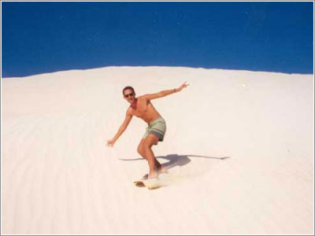
Sandboarding

Slide 12
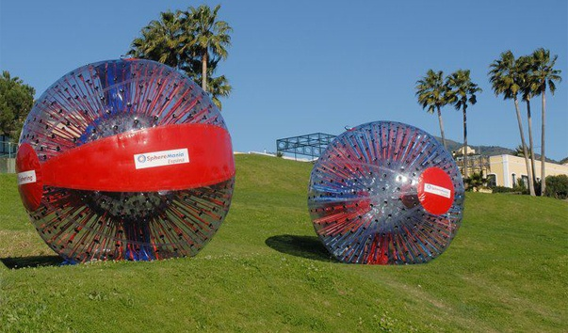
Zorbing

Slide 13
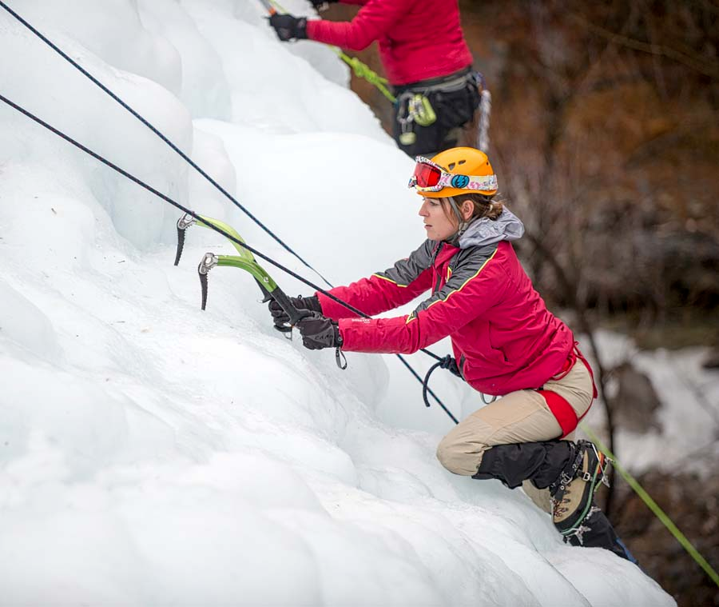
Ice climbing

Slide 14
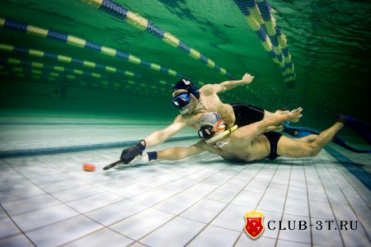
Underwater hockey

Slide 15
Fill
 | 1 | 2 | 3 | 4 | 5
Speaker | B | F | C | A | E

Slide 16
My favourite sport
1. My favourite sport is…..
2. I do (go, play)…….. twice a week.
not very often.
all the time.
3. I have been doing (going, playing) it about a year.
4. I need a special equipment….(SB ex.5 p.129)
5. I like it because it makes me strong, brave, healthy and beautiful.
6. I do my sport just for fun (to be fit, for my parents…..)

Slide 17
Thank you

