Slide 1
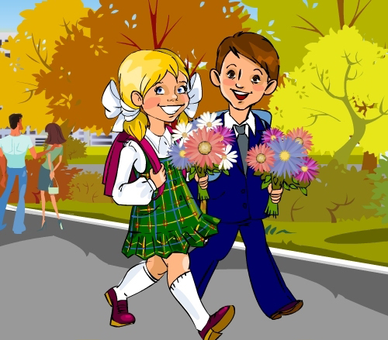
It is warm in September. The sky is blue. There are white
clouds in the sky. I go to school in
September.

Slide 2
It is cold in October.
It is windy.
The trees are yellow,
orange, red and brown.
They are nice.

Slide 3
It is cold in November.
It is wet and muddy.
There are grey clouds in the sky.
I don’t like rainy days in November

Slide 4
It’s rainy day today,
It is cold and wet.
It’s a pity, I can’t play
Football with my friend.

Slide 5
Orange, red, yellow and brown,
Autumn leaves are falling down.
Look at clouds in the sky:
They are grey and black…and white

Slide 7
