Slide 1

The 15th of April
Read and translate
White teeth, short hair, small toes,
long legs, angry eyes, clean knees,
big feet, kind face, beautiful fingers

Slide 2
Fill in the gaps
n_ _ _, f_ _ _, n_ _ _, e_ _, e_ _, l_ _, t _ _,
f_ _ _ _ _, k_ _ _, s_ _ _ _ _ _ _, h_ _ _,
h_ _ _, a_ _, m_ _ _ _, f_ _ _, t_ _ _ _

Slide 3
Let’s check
n_ _ _, f_ _ _, n_ _ _, e_ _, e_ _, l_ _, t _ _,
f_ _ _ _ _, k_ _ _, s_ _ _ _ _ _ _, h_ _ _,
h_ _ _, a_ _, m_ _ _ _, f_ _ _, t_ _ _ _
neck, face, nose, ear, eye, leg, toe, finger, knee, shoulder, head,
hand, arm, mouth, foot, tooth

Slide 4
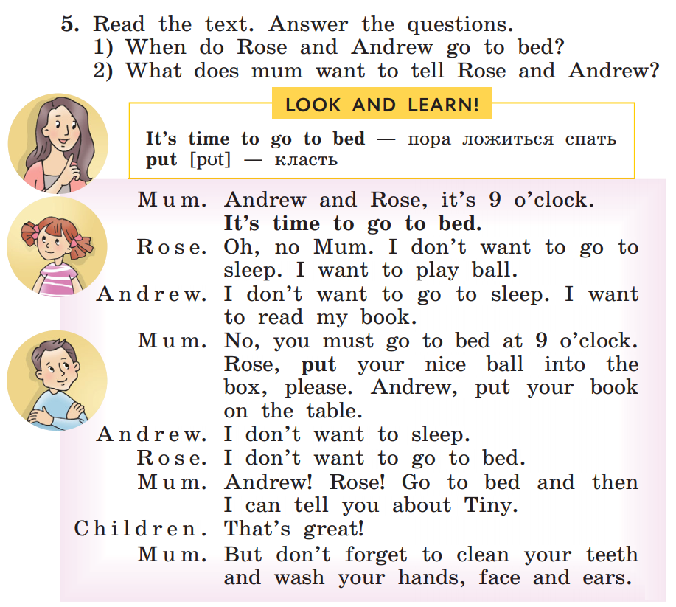

Check the home task
Стр 99 упр 5
выразительное чтение

Slide 5
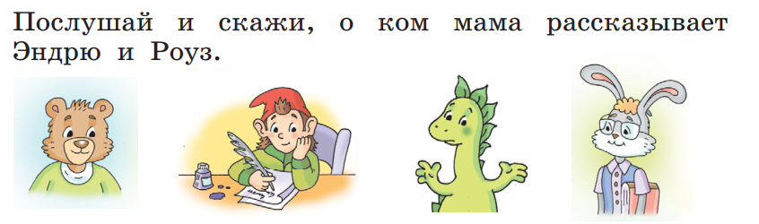
Listening p.98 ex.1
Billy Tiny Dino Martin

Slide 6
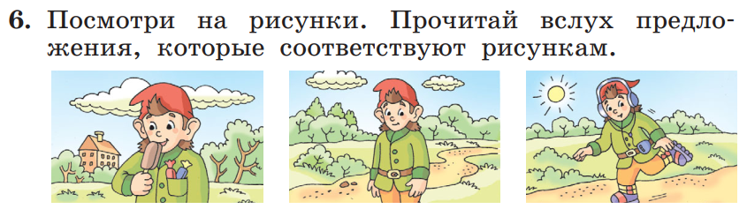
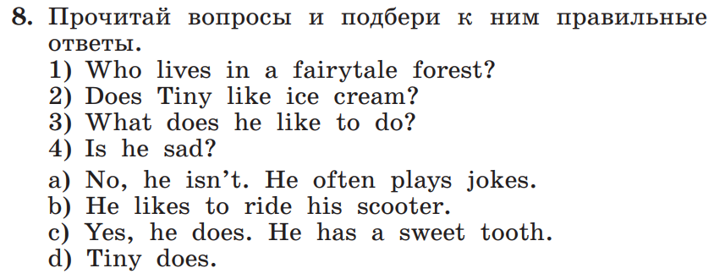
Стр 101 упр 6, 8

