Slide 1

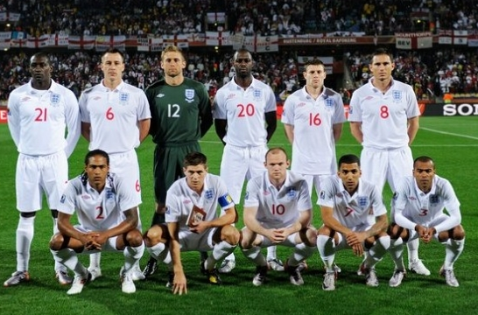
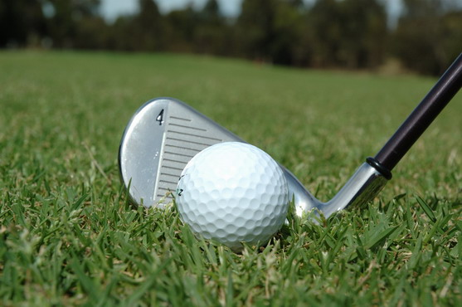
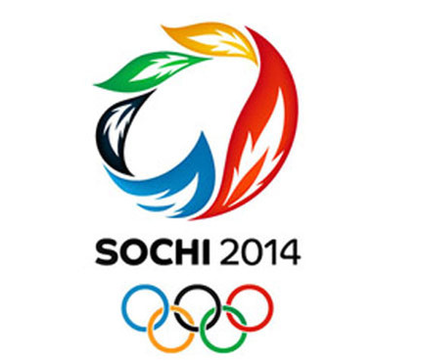

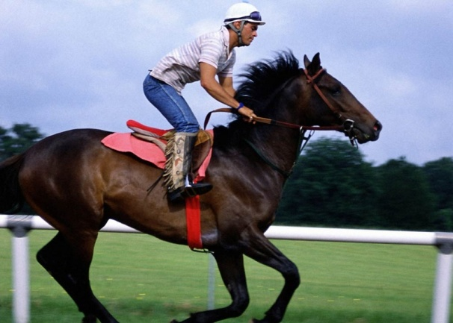
What popular sports in Britain and Russia do you know?

Slide 2
Look at Ex. 50 p. 142. Listen and repeat the words. Complete the table.
Winter sports
Indoor sports
Sport
Water sports
Sports which you play with a ball
Outdoor sports

Slide 3

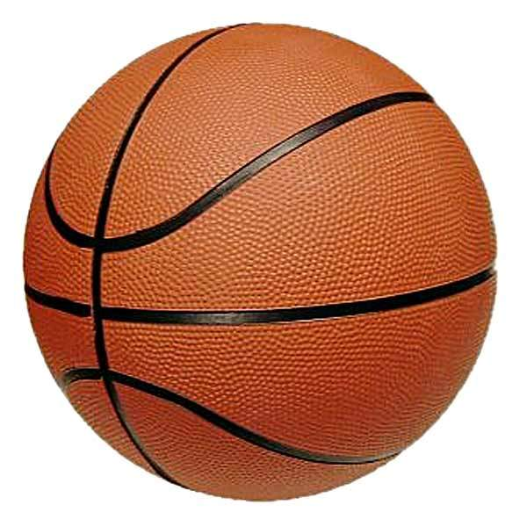
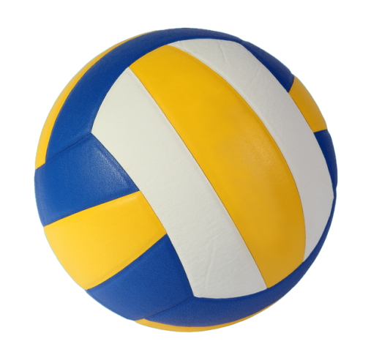
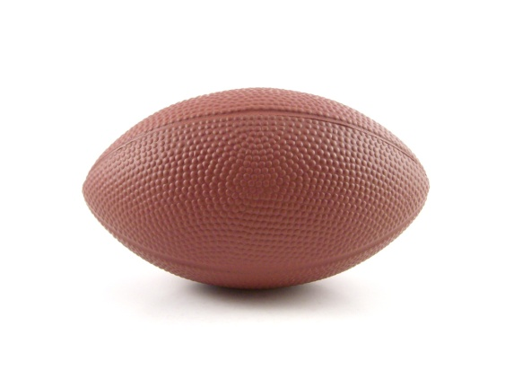
Do you know the rules of ball games well? Match the games and the rules.
The ball is usually played with the hands or arms, but players can legally push the ball with any part of the body.
A player can’t use his hand to push or throw the ball. He can only play with his feet and head.
A player cannot run with the ball. The player must throw it on the spot. The arms and body must not be used for holding it.
A player can carry the oval ball with his hands. The players can move forward only by running with the ball or by kicking it.
football
basketball
volleyball
rugby

Slide 4


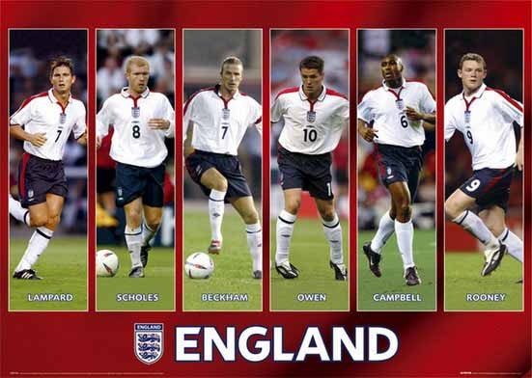
British national sport is football or soccer

Slide 5
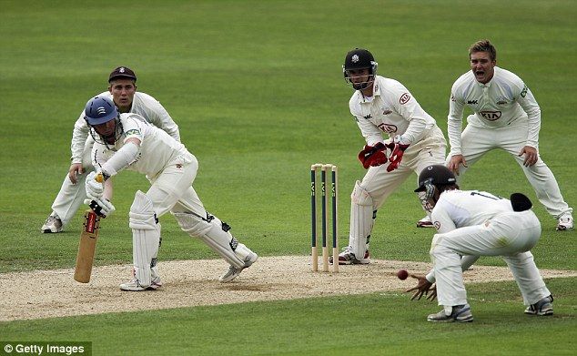
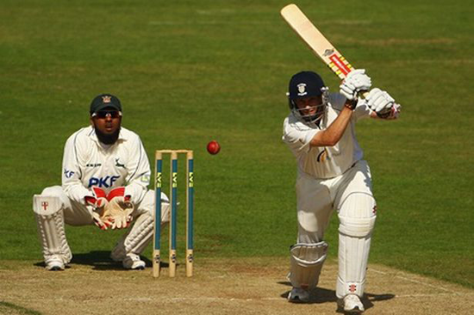
Cricket is a popular summer sport in Britain

Slide 6
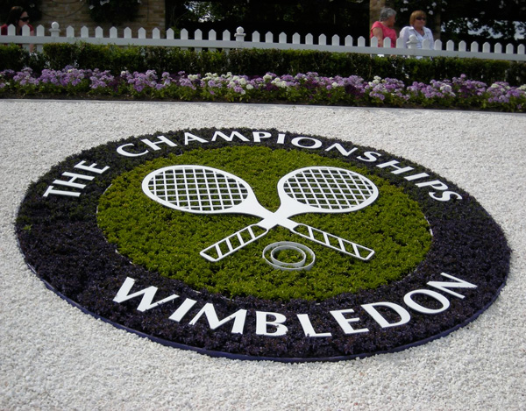
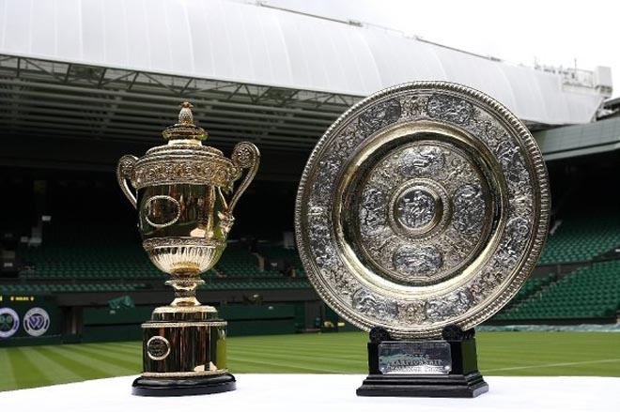
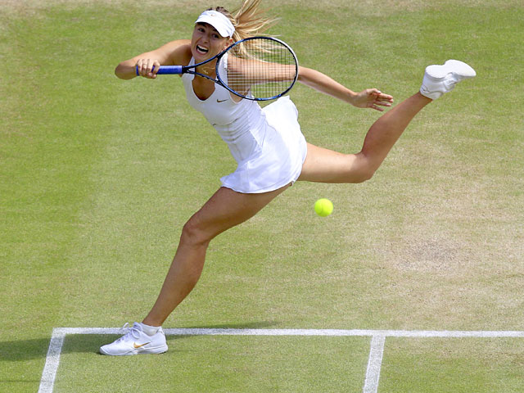
Tennis is another favourite sport of the Englishmen

Slide 7
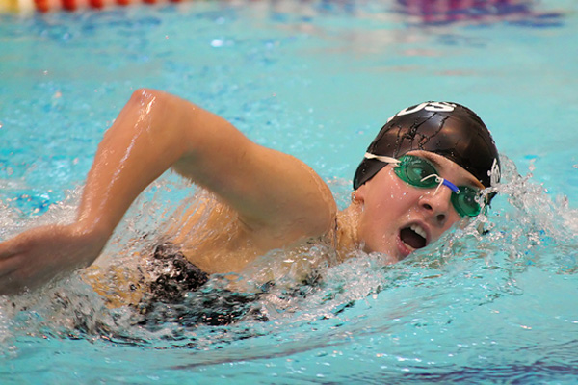
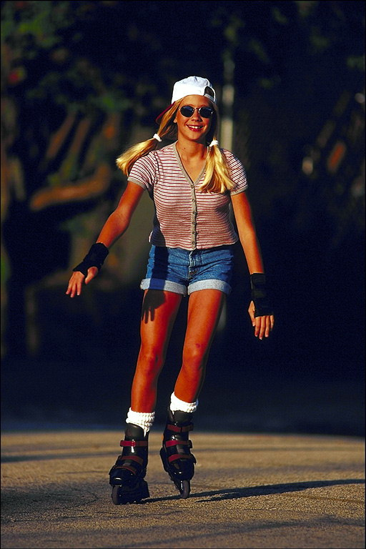

Popular Sport in Russia

Slide 8
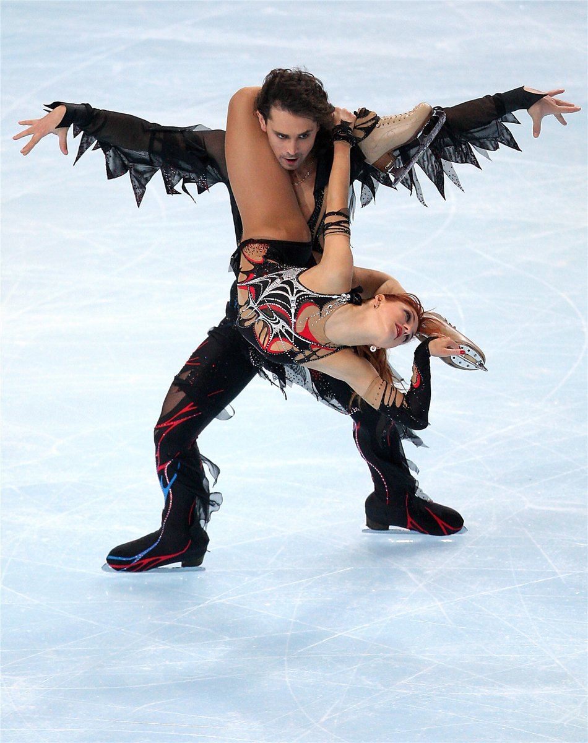
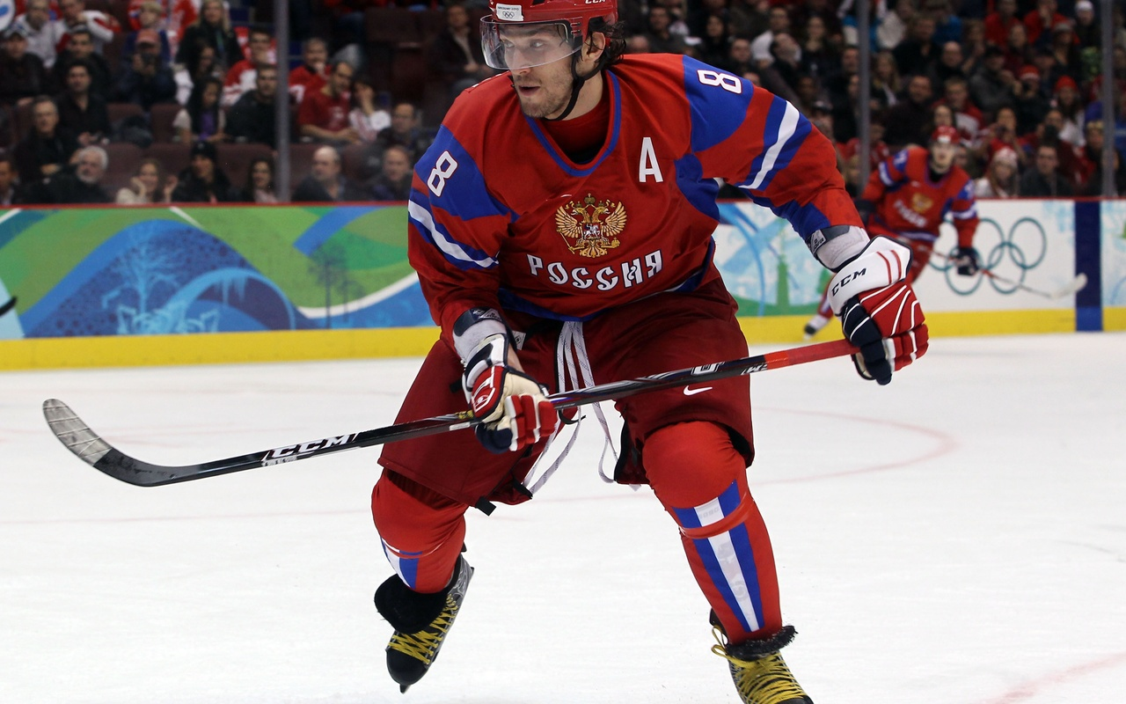
Figure Skating and Hockey

Slide 9
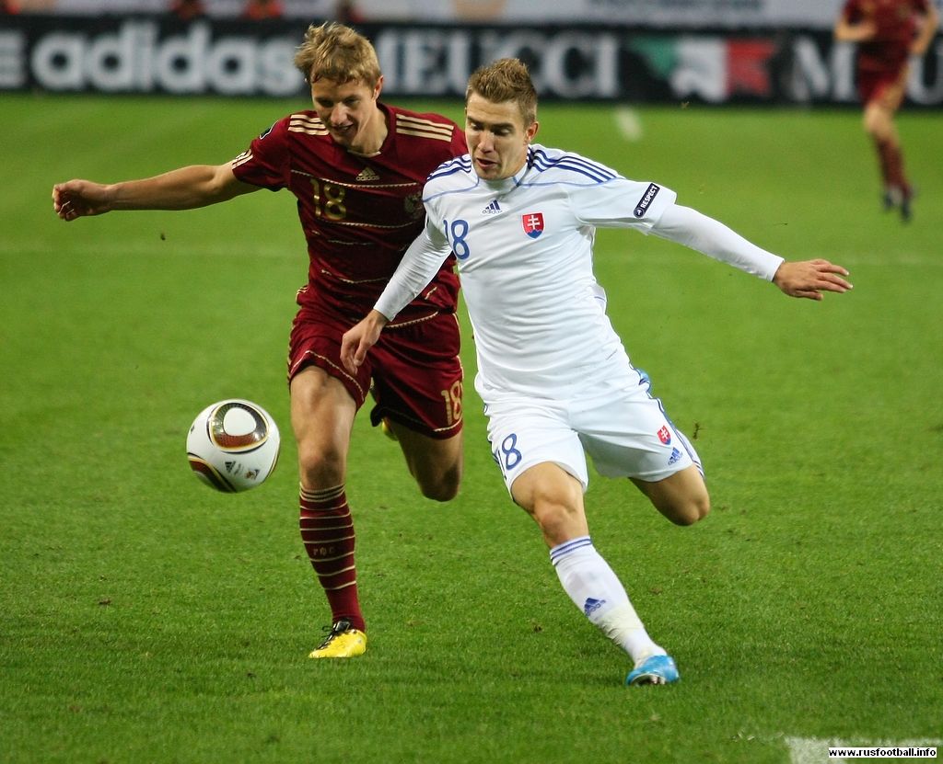
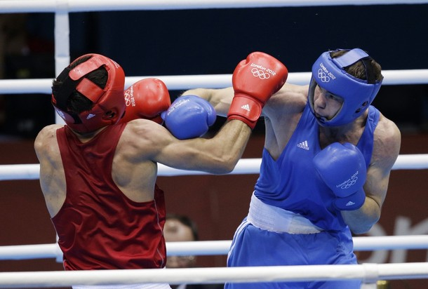
Football and Boxing

Slide 10
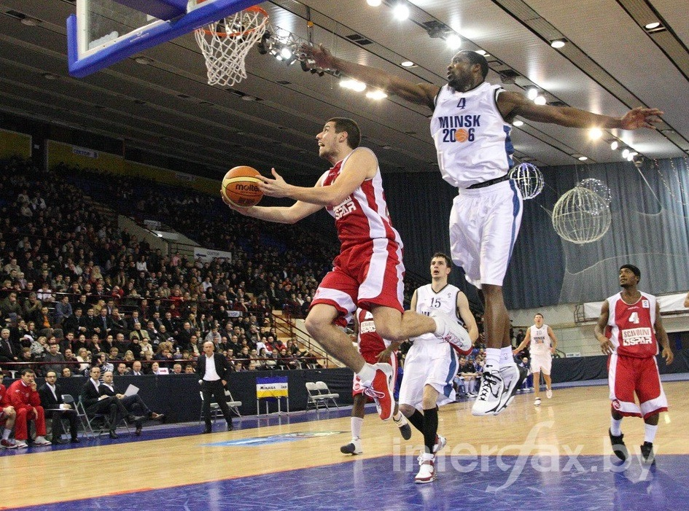
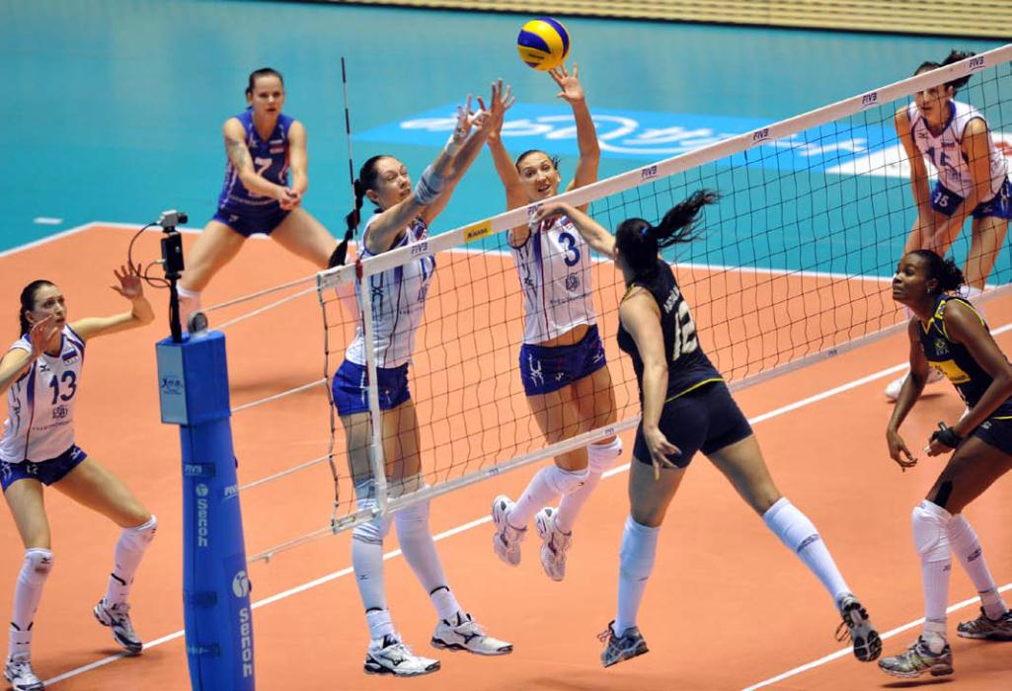
Basketball and Volleyball

