Slide 1
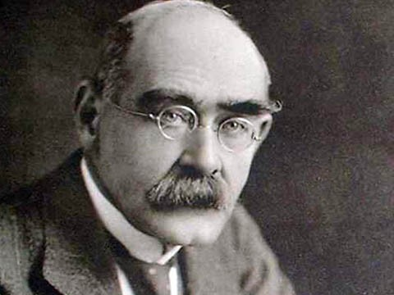
(December 30, 1865, Bombay -
January 18, 1936, London)
Rudyard Kipling
has been done by Podkina I.A/

Slide 2
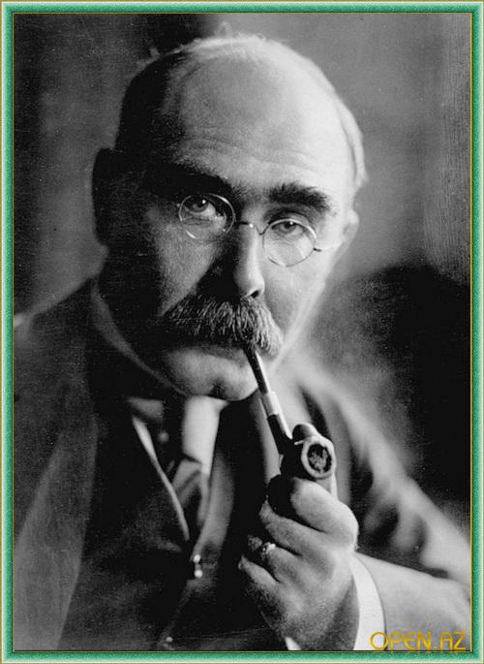
Rudyard Kipling
Kipling had strong peasant roots. Great-grandfather of the writer's father's side was a farmer, but his eldest son, Joseph, became a priest. He married the daughter of Lord Mulgrave. As a result, their marriage was born John Kipling, who later became the father of the famous writer.

Slide 3
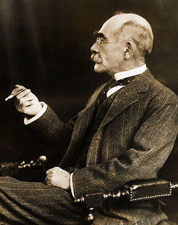
Rudyard Kipling
John graduated from art school in London, where he studied painting and sculpture. His father's death in 1862 forced him to do a permanent job in companies manufacturing in china Bersleme. There he met and became engaged to his future wife, Alice McDonald.

Slide 4
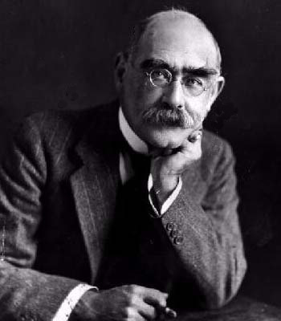
Rudyard Kipling
Feed a family on a salary of an applied artist was difficult. So when he was offered the post of teacher of art school in Bombay, John readily agreed. Married in London, John and Alice Kipling three weeks later sailed to India. It was in May 1865 30 December of the same year they had a son, named Rudyard.

Slide 5
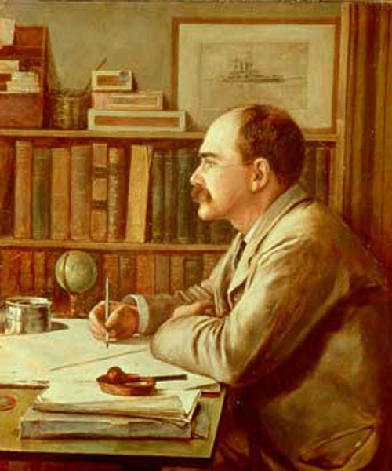
Rudyard Kipling
Kipling quickly gained popularity in the Anglo-Indian society. John, in addition to teaching, he became a correspondent of the influential newspaper. Alice wrote for various newspapers and magazines. Their house was surrounded by a beautiful garden, the family served the crowd of servants. Now had two children: in 1868, appeared in Rudyard sister Alice, whom the family called "Trix" (naughty). Early childhood Kipling later recalled as the time of unalloyed happiness.

Slide 6
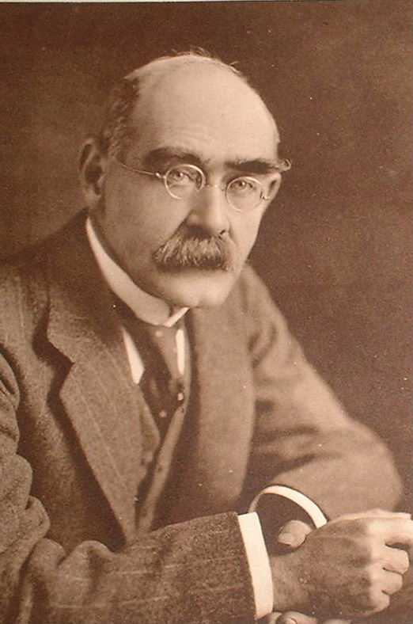
Rudyard Kipling
In the Anglo-Indian families was made to send children to grow up in England. In 1871, Kipling and Trix identified Ruddy on board in Holloway family, to people they do not know, but quite worthy pal. But in 1874, the family head Captain Holloway died, and mistress of the house was his wife. From this moment life has become unbearable Rudyard. Mrs. Holloway feels obliged to correct this spoiled child, with every possible way humiliating.

Slide 7
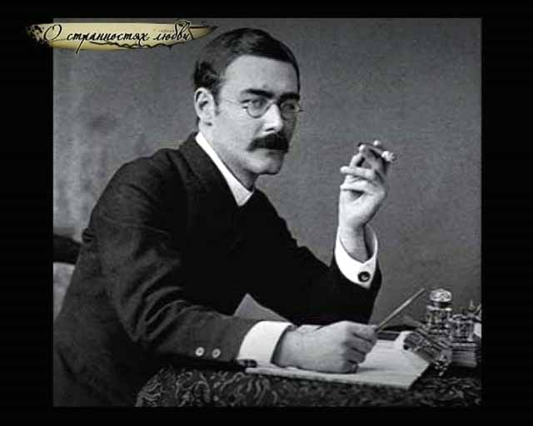
Rudyard Kipling
The only salvation was reading. Rudyard read voraciously, everything. But Mrs. Holloway noticed this craze boy, he began to take the book. Realizing what was happening, in 1877 Mother Rudyard children taken away to London and spent a few months with her sister, where she was involved in their upbringing. At the age of twenty-three Kipling wrote the story "Mae-e, Black Sheep", which tells about the suffering endured by him from Holloway. Hate to this house he retained forever.
.

Slide 8
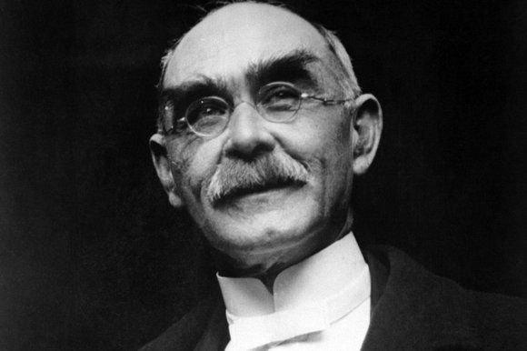
Rudyard Kipling
In 1878 Ruddy was sent to the new school. It was a military-type institution, but it was headed Kormell Price, which can be considered one of the spiritual fathers of Kipling. It was while studying at this school have appeared Ruddy innate quality writer. Many years later, Kipling wrote ten positive stories about their school, Kipling tried to prove that it was within its walls have been hardened true servants of the empire.
.

Slide 9
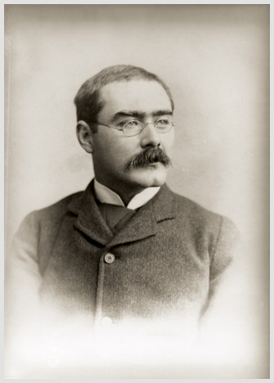
Rudyard Kipling
In 1882, after graduating from school in incomplete seventeen years, Kipling, went to India. Rudyard parents lived since 1875 in Lahore, capital of Punjab. His father got a place here central museum curator of Indian art and became director of the school of applied arts. So Kipling house in Lahore resembled a small palace.

Slide 10
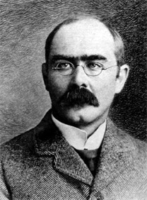
Rudyard Kipling
Parents managed to attach his son in the evening "civilian and military newspaper" as assistant editor. Amount of material that he cranked out for the day, was surprising. That newspaper work helped him to start regularly published, and it also gave him a wealth of knowledge India.

Slide 11
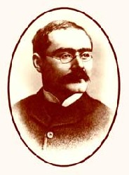
Rudyard Kipling
The newspaper had a special column, reserved for stories, Kipling and it completely captured. His heroes were the colonial officials, doctors, engineers, soldiers and officers. He quickly settled in the community of Anglo-Indians who knew what and how they live, what they think.

Slide 12
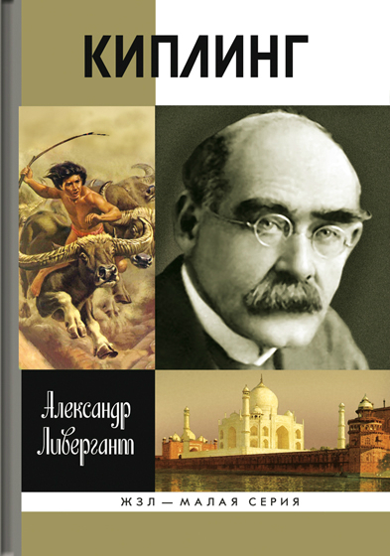
Rudyard Kipling
In the years 1886-1887 Rudyard published thirty-five stories about India. They discussed the family council, twenty nine found worthy reissues, adding to them three more unreleased. Then come up with a name for the first book by Rudyard - "Simple stories from the mountains." Kipling later added to his collection of eight more stories. The book was published in 1888 and formed the basis of his future glory.
.

Slide 13
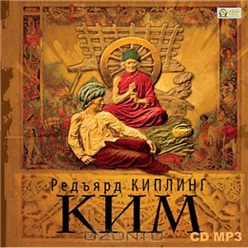
Rudyard Kipling
In a short time Kipling wrote six small booklets of stories published in the "Indian Railway Library of" reading in a way. Among other things, Kipling made ​​in India not only as a novelist but also as a poet. In India, Kipling became known in England, but none of it had. However, did not last long.

Slide 14
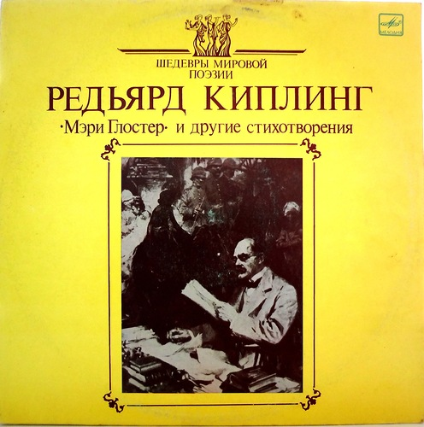
Rudyard Kipling
In 1889 in England published a book with the best poems and "Simple Stories" Kipling. At the end of 1888 Rudyard drawn in England, but he decided to go back through the Far East and the USA. Thus was born the book of travel essays, "From sea to sea", performed accurate observations and humor.

Slide 15
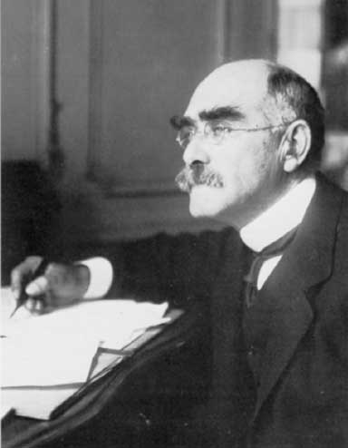
Rudyard Kipling
In London, where he returned in the autumn of 1889 in the U.S., he had to wait for long hours of his fame. His literary reputation has grown very quickly. V1891, the Kipling wrote an adventure novel "Neulaha" with his friend, Wolcott Balestier American. When work on the novel was finished, Walcott became ill with typhoid fever and died.

Slide 16
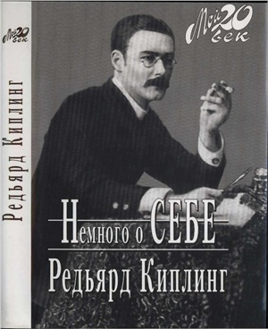
Rudyard Kipling
Five weeks later, on January 18, 1892 Rudyard married Caroline. There in July 1893 Kipling was born of his beloved daughter, Josephine. But after a major row between Kipling and his brother-he and his wife in 1902 returned to England. They now have two children: a daughter in 1896 g.rodilas Elsie, as in 1897. - Son of John, but in 1899 Kipling experienced the loss - the death of the first daughter Josephine.

Slide 17

Rudyard Kipling
American period in the life of Rudyard - the most fruitful for him. It is here finally formed philosophy Kipling. He wrote two "Jungle Book", began to create their own stories, began to "Kim”.

Slide 18

Rudyard Kipling
Output of these works (the last "Just tales" published in 1902) has exhausted the creative impulse derived Kipling in India. Of course, later he appeared successful stories and poems, but only on occasion. Kipling remained so in the history of literature - a storyteller, novelist, poet, storyteller, illustrator.

Slide 19
Rudyard Kipling
In 1933, Parisian doctor found that Kipling fifteen years suffering from a duodenal ulcer. Low: 12 January 1936. He was ill in the hospital an hour later had the surgery, but he began peritonitis and 12:00 January 18, 1936 he died. Official England solemnly Kipling spent his last journey.

Slide 20
Rudyard Kipling – If (Если)
If you can keep your head when all about you
Are losing theirs and blaming it on you;
If you can trust yourself when all men doubt
you,
But make allowance for their doubting too:
If you can wait and not be tired by waiting,
Or, being lied about, don't deal in lies,
Or being hated don't give way to hating,
And yet don't look too good, nor talk too wise;
If you can dream - and not make dreams your
master;
If you can think - and not make thoughts your
aim,
If you can meet with Triumph and Disaster
And treat those two impostors just the same
О, если ты спокоен, не растерян,
Когда теряют головы вокруг,
И если ты себе остался верен,
Когда в тебя не верит лучший друг.
И если ждать умеешь без волненья,
Не станешь ложью отвечать на ложь,
Не будешь злобен, став для всех мишенью,
Но и святым тебя не назовешь.
И если ты своей владеешь страстью,
А не тобою властвует она,
И будешь твёрд в удаче и несчастье,
Которым, в сущности, одна цена.

Slide 21
Rudyard Kipling – If (Если)
If you can bear to hear the truth you've spoken
Twisted by knaves to make a trap for fools,
Or watch the things you gave your life to, broken,
And stoop and build 'em up with worn-out tools;
If you can make one heap of all your winnings
And risk it on one turn of pitch-and-toss,
And lose, and start again at your beginnings,
And never breathe a word about your loss:
If you can force your heart and nerve and sinew
To serve your turn long after they are gone,
And so hold on when there is nothing in you
Except the Will which says to them: "Hold on!"
И если ты готов к тому, что слово
Твое в ловушку превращает плут,
И, потерпев крушенье, можешь снова,
Без прежних сил, возобновить свой труд.
И если можешь всё, что стало
Тебе привычным, выложить на стол,
Всё проиграть и вновь начать сначала,
Не пожалев того, что приобрёл.
И если можешь сердце, нервы, жилы
Так завести, чтобы вперед нестись,
Когда с годами изменяют силы
И только воля говорит: "Держись!"

Slide 22
Rudyard Kipling – If (Если)
If you can talk with crowds and keep your virtue,
Or walk with Kings - nor lose the common touch,
If neither foes nor loving friends can hurt you,
If all men count with you, but none too much:
If you can fill the unforgiving minute
With sixty seconds' worth of distance run,
Yours is the Earth and everything that's in it,
And - which is more - you'll be a Man, my son!
И если можешь быть в толпе собою,
При короле с народом связь хранить,
И, уважая мнение любое,
Главы перед молвою не клонить.
И если будешь мерить расстоянье
Секундами, пускаясь в дальний бег,
Тогда Земля - твоё, мой мальчик, достоянье.
И более того, ты - Человек!
(в переводе С. Маршака)

Slide 23
Thank you for your attention

