Slide 1
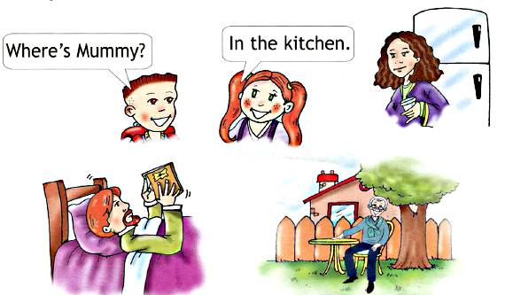
What`s this? Where`s mummy?
Презентация к
учебнику «Spotlight-2
Тема «My House»
Подготовила:
учитель английского языка
МБОУ СОШ №5
Баландина Ю.В.
г. Нелидово, Тверская область

Slide 2
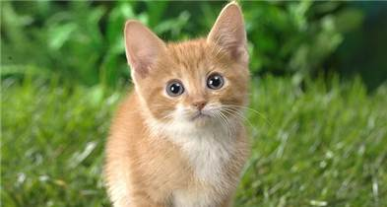
What`s this?
It`s a ….

Slide 3
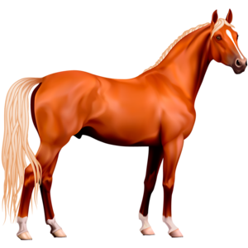
It`s a ….

Slide 4
It`s a ….

Slide 5
It`s a ….

Slide 6
It`s a ….

Slide 7
It`s a ….

Slide 8
It`s a ….

Slide 9
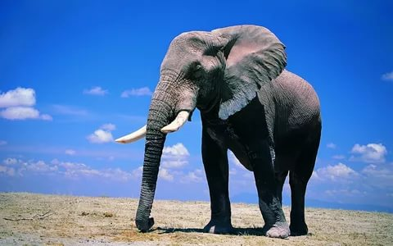
It`s a ….

Slide 10
It`s a ….

Slide 11
It`s a ….

Slide 12
It`s a ….

Slide 13
It`s a ….

Slide 14
It`s a ….

Slide 15
What`s this?

Slide 16
What`s this?

Slide 17
What`s this?

Slide 18
What`s this?

Slide 19
What`s this?

Slide 20
Where`s Mummy?
She`s in the….

Slide 21
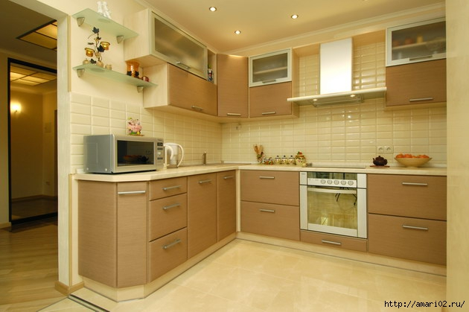
Where`s Grandma?
She`s in the ….

Slide 22
Where`s Daddy?
He`s in the ….

Slide 23
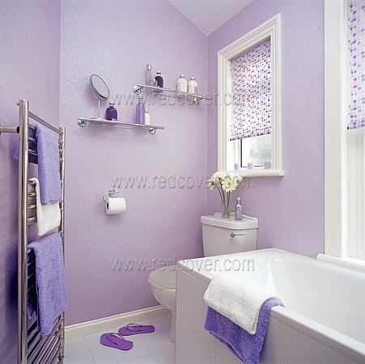
Where`s Grandpa?
He`s in the ….

Slide 24
Where`s Sister?
She`s in the…

Slide 25
Is he in the…?
Yes, he is
No, he isn`t

Slide 26
Is he in the…?
Yes, he is
No, he isn`t

Slide 27
Is he in the…?
Yes, he is
No, he isn`t

Slide 28
Is he in the…?
Yes, he is
No, he isn`t

Slide 29
Is he in the…?
Yes, he is
No, he isn`t

Slide 30
Is she in the…
Yes, she is.
No, she isn`t.

Slide 31
Is she in the…
Yes, she is.
No, she isn`t.

Slide 32
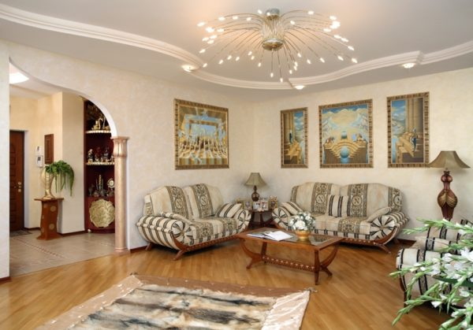
Is she in the…
Yes, she is.
No, she isn`t.

Slide 33
Is she in the…
Yes, she is.
No, she isn`t.

Slide 34
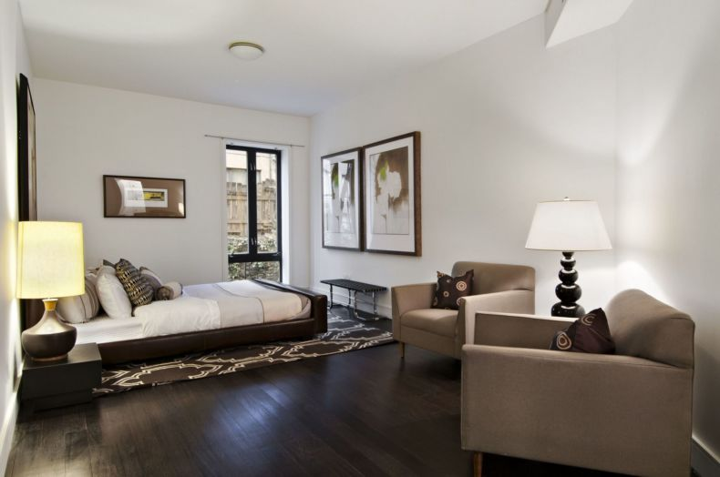
Is she in the…
Yes, she is.
No, she isn`t.

Slide 35
Yes, he is Yes, she is No, he isn`t No, she isn`t
Is she in the garden?
Yes, ……
Is he in the kitchen?
No, …….
Is she in the bathroom?
No,……

Slide 36
Yes, he is Yes, she is No, he isn`t No, she isn`t
Is she in the bedroom?
Yes,…..
Is she in the living room?
Yes,……
Is he in the garden?
No, he,…..

