Slide 1
Anglicisms in the Information and computer technologies
Выполнили:
Студенты группы 204-ИС-23
Мукумова Виктория и Красильникова Анжелика

Slide 2
Introduction
Anglicism is a word, idiom, or characteristic feature of the English language occurring in or borrowed by another language.
At the beginning of the 20th century, many linguists studied the reasons for the penetration of foreign vocabulary into the language. Any anglicism in Russian, according to P. Krysin, appears for the following reasons:
1. The need to name a new phenomenon or thing.
2. The need to distinguish between fairly close, but still different concepts.
3. The tendency to designate a whole object with one concept, rather than several combined words.
4. The need for separation of concepts for certain purposes or areas.
5. Relevance, prestige, expressiveness of a foreign concept.
The reasons for borrowing anglicisms in modern Russian are actually much more extensive. One of them is that the number of Russian people who speak English has increased. At the same time, the use of foreign vocabulary by authoritative personalities and popular programs also gave a powerful impetus to the development of this process.

Slide 3
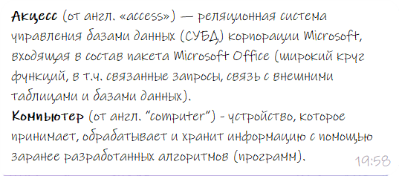
The use of Anglicisms in IT. Creating a Database in Access

Slide 4
The use of Anglicisms in IT. Creating a Database in Access

Slide 5
The use of Anglicisms in IT. Creating a Database in Access

Slide 6
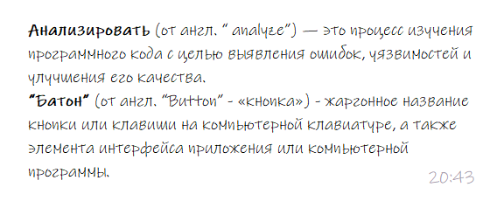
The use of Anglicisms in IT. Creating a Database in Access

Slide 7
The use of Anglicisms in IT. Creating a Database in Access

Slide 8
The use of Anglicisms in IT. Creating a Database in Access

Slide 9
The influence of Anglicism on the language
Positive and negative aspects
There are both positive and negative sides of borrowing anglicisms.
The positive aspects consist of:
The opportunity to communicate with people from other counties or people of different nationalities;
The possibility to learn more about other cultures;
The chance to develop your language skills and keep abreast with the time.
The negative aspects consist of:
The possibility of losing the values of our native language;
The possibility to forget your native culture in pursuit of foreign values;
Sounding absurd and being misunderstood as a result of wrong use of foreign words.

Slide 10
Conclusion
We can say with confidence that anglicisms are necessary for the Russian language since modern technologies are developing at an incredible speed. Literally, in 10 years, a huge breakthrough has been made in the development of technologies.
Consequently, with the appearance in our life of new phenomena, gadgets and objects, they need to be given a name, and that is why anglicisms come to the Russian language

Slide 11
Thank you for your attention!

