Slide 1




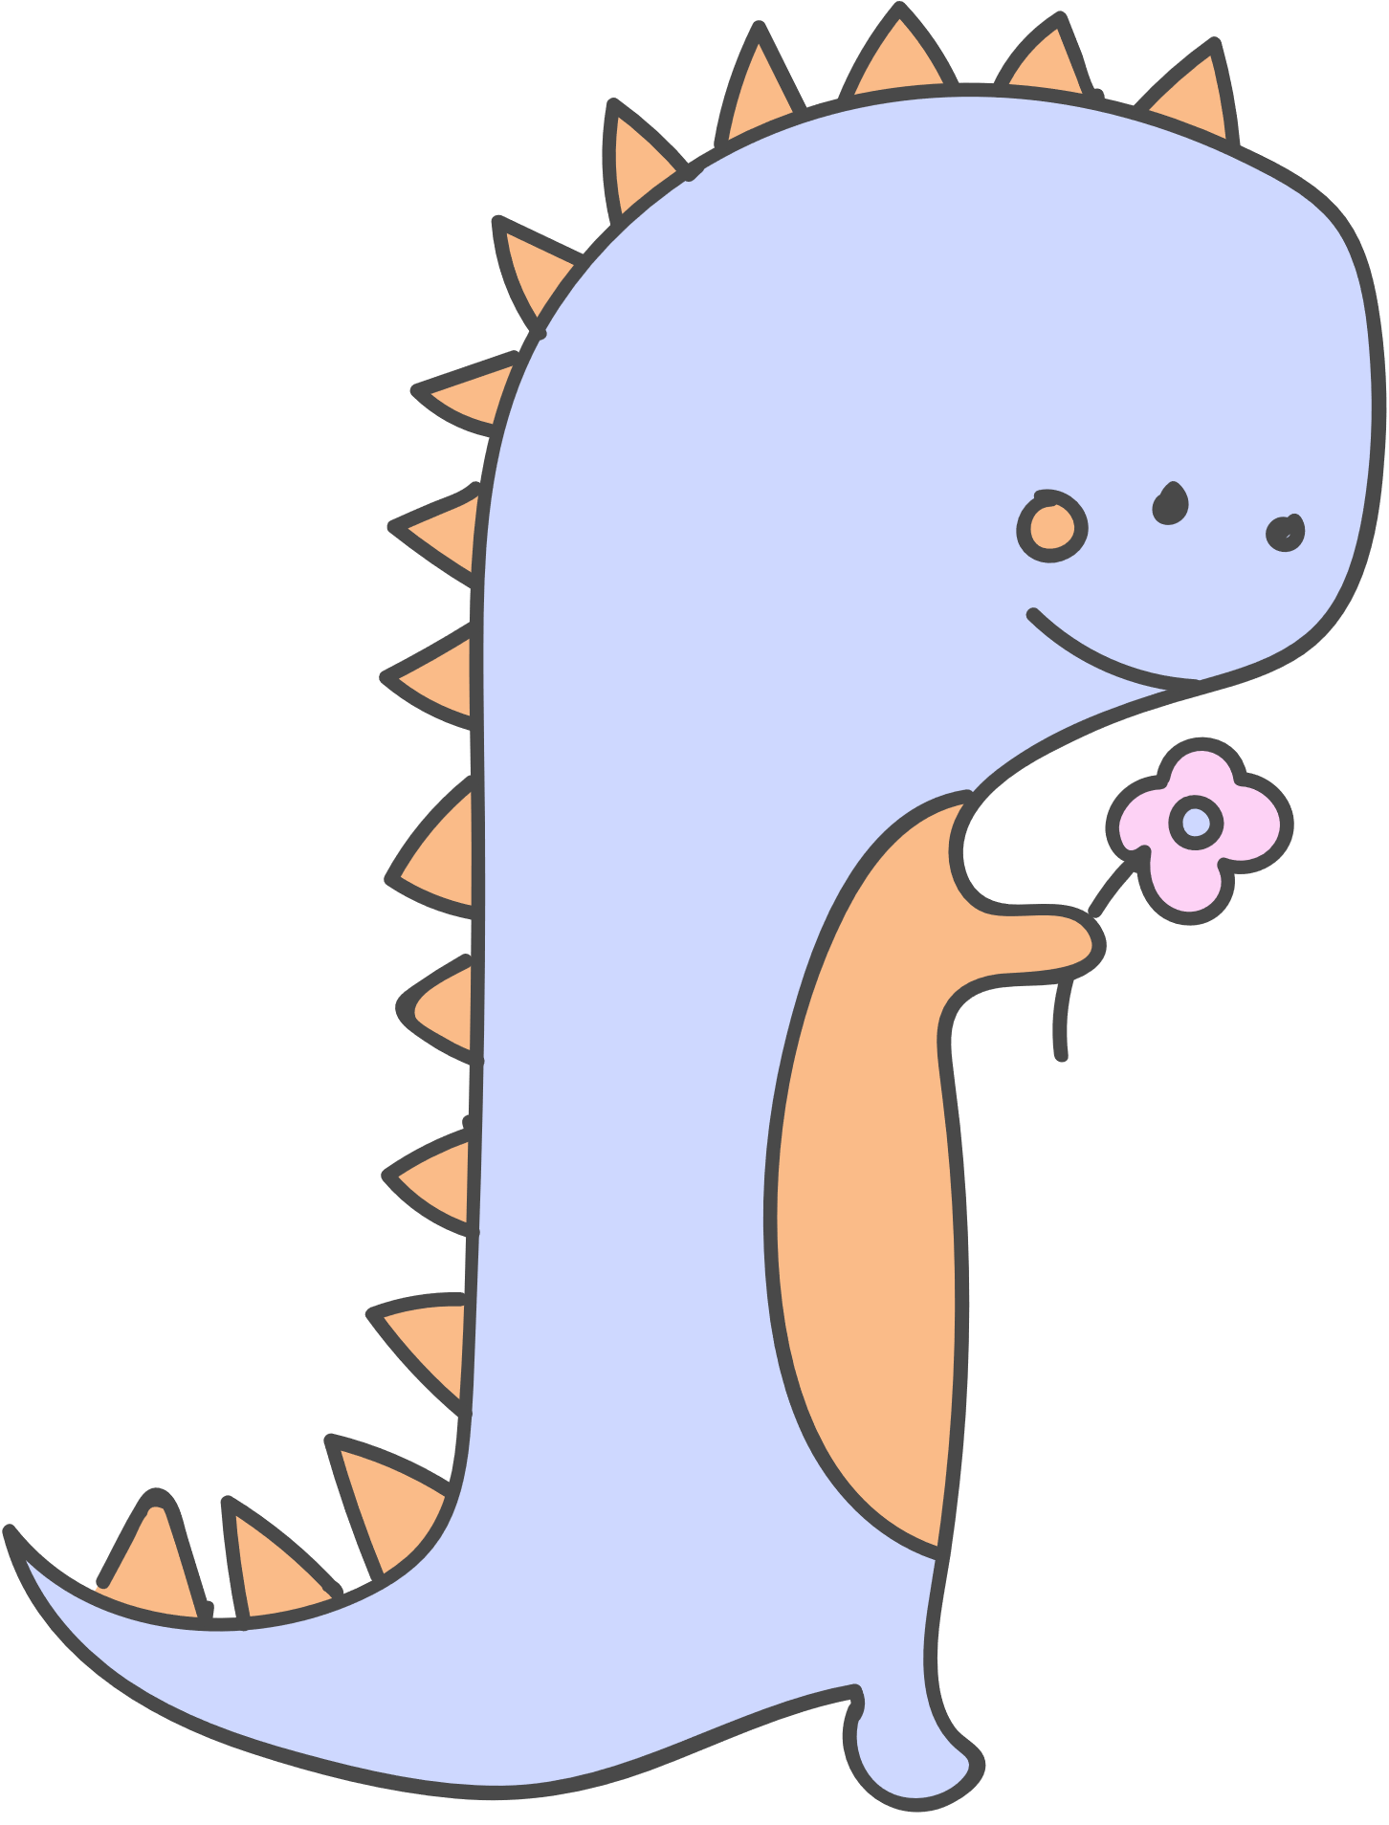

Young learners
age 5-7
Family and friends Starter

Slide 2



https://yandex.ru/video/preview/2880281943101691585
Count words “cat”
in the toungue
twister!
I see a big black cat
big black cat.
What a cat?
What a cat?
What a big black cat?

Slide 3





Let’s count!
How many cats
do you see?

Slide 4


big
big
or
small?
small

Slide 5
Count
big and small
cats!

Slide 6





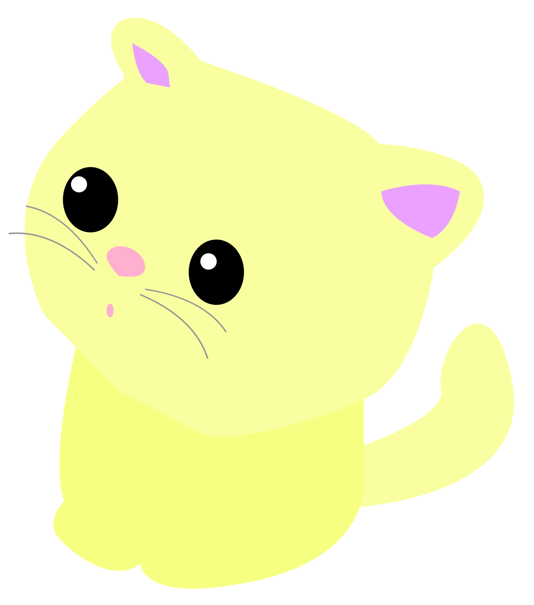
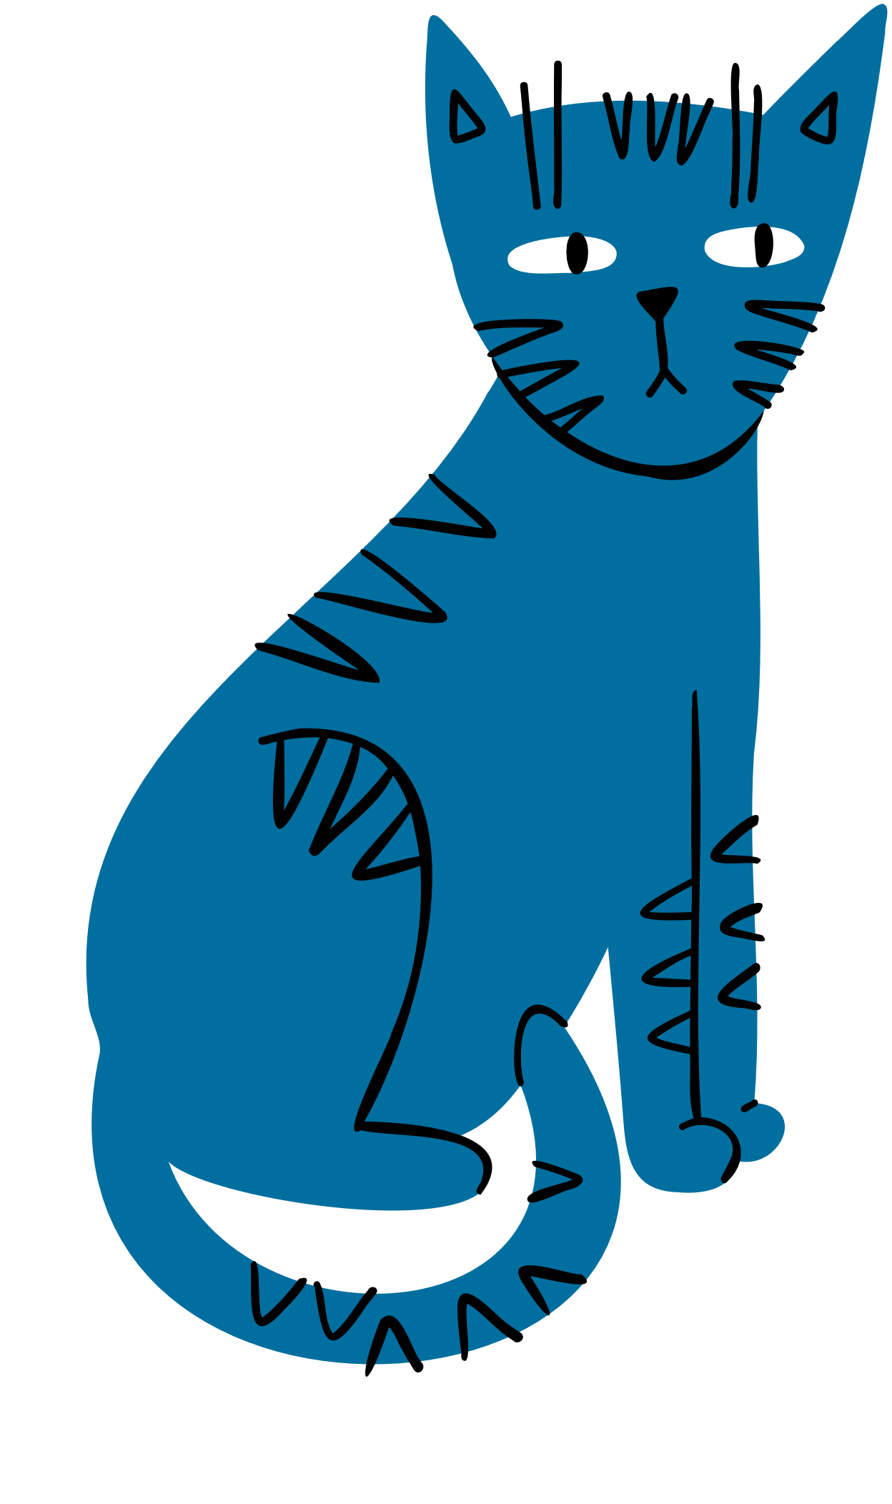
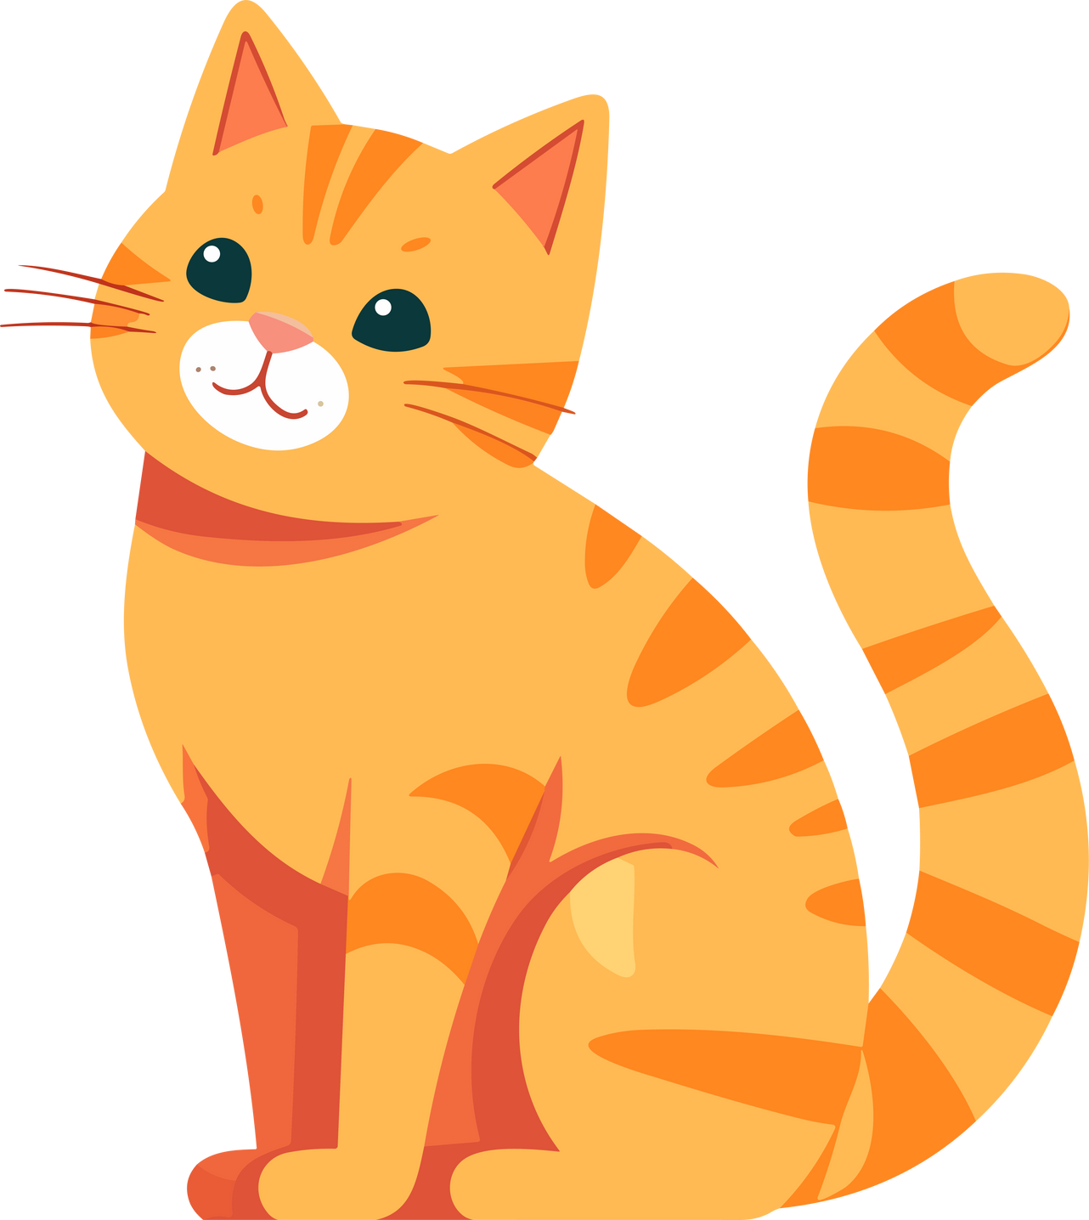

What colour
are these
cats?

Slide 7
https://yandex.ru/video/preview/2880281943101691585
https://yandex.ru/video/preview/13356872073524268621
What is its name?
Tim
Tom
Bob

Slide 8






Annie
a
apple
A
A
p
a
What is
the same?
a
A
a
cat

Slide 9

Goodbye!

